Slide 1
CSM51A Discussion Week #1
Hyunjin Kim

Slide 2
Outline
Number conversion
binary, Octal, Hexadecimal, or Decimal
fixed or mixed-radix
Signed Integer Representation
Boolean Algebra (Appendix A)

Slide 3

Integer Domain Conversion
Decimal | Binary
0 | 0000
1 | 0001
2 | 0010
3 | 0011
4 | 0100
5 | 0101
6 | 0110
7 | 0111
8 | 1000
9 | 1001
10 | 1010
11 | 1011
12 | 1100
13 | 1101
14 | 1110
15 | 1111
Decimal: 10^{i}
Binary: 2^{i}
Example
37
511
(10111101)₂
(1234)₈
(EC76)₁₆ ->(?)₈

Slide 4
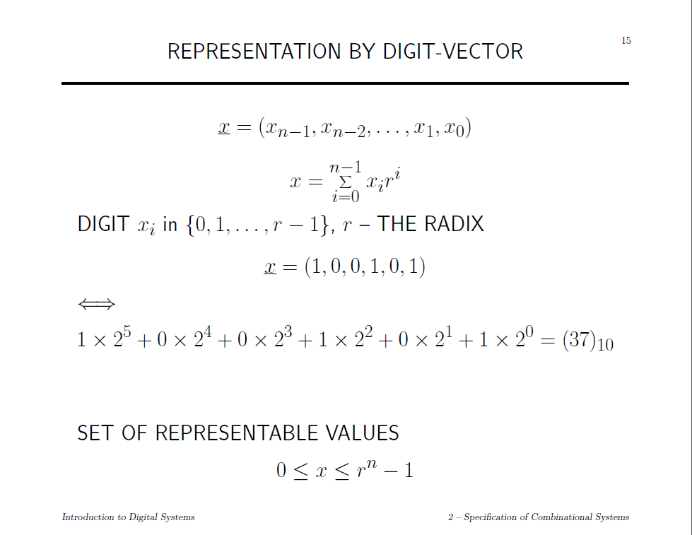

Slide 5
Mixed-Radix
X=(x, y, z) is a 3-digit weighted mixed-radix number system: x is a radix-16, y is a radix-3, and z is a radix-12
Convert X=(6, 1, 11) to a decimal number
The largest number of X in decimal?
LargetstX = r_{n-1} x r_{n-2} x … x r₀ -1 = 16 x 3 x 12 - 1 = 576 – 1 = 575

Slide 6
Why 2’s complement
Sign-and-Magnitude
Two zero
Signs of result depends on sign of number with the larger magnitude (additional operation)
1’s complement
Two zero
End around carry (additional operation)

Slide 7
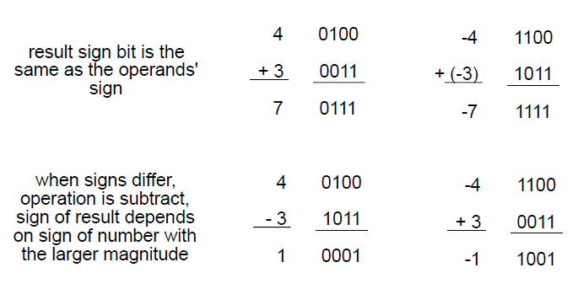
SM add/sub

Slide 8
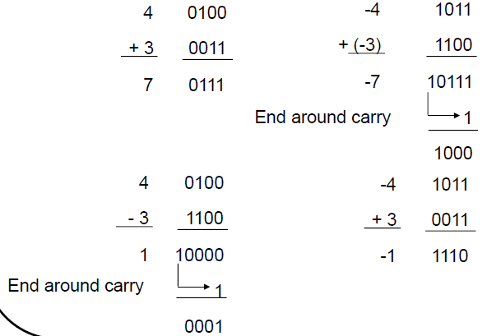
1’s Complement add/sub

Slide 9
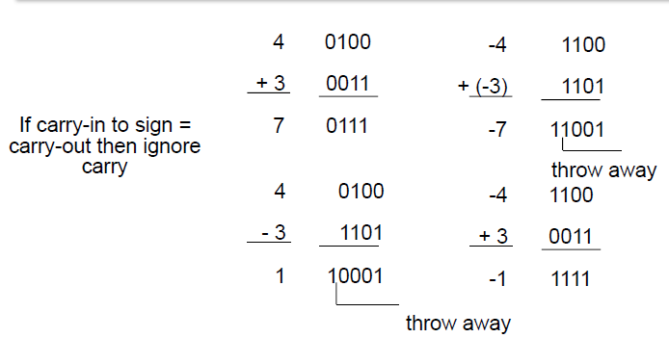
2’s complement
Simpler Addition scheme makes two’s complement the most common integer number systems in digital systems.

Slide 10
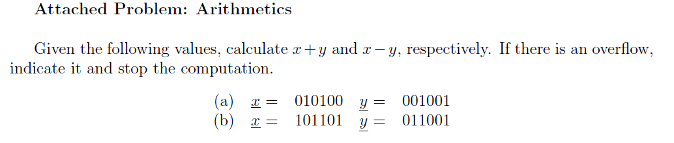

Slide 11
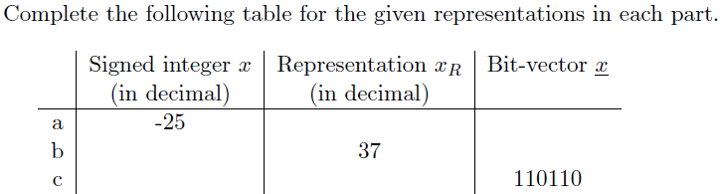
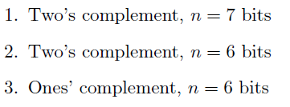

Slide 12
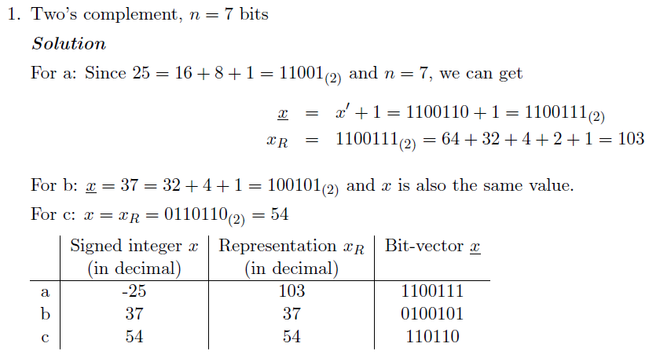

Slide 13
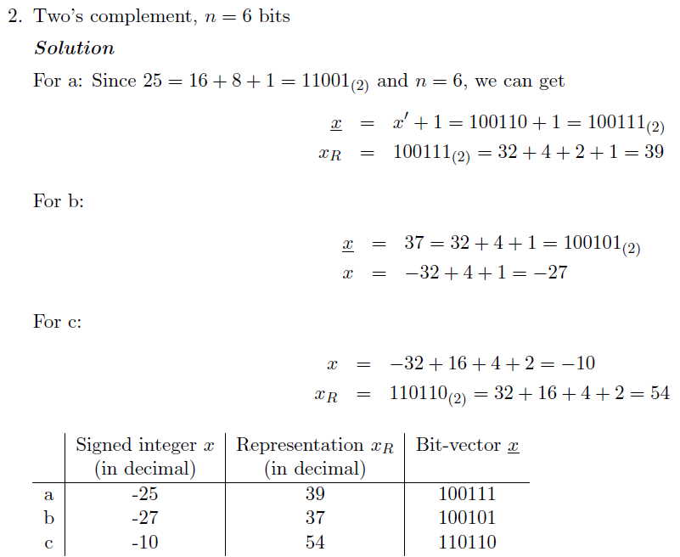

Slide 14
Overflow Detection in Addition
Overflow
Result exceeds most positive or negative representable integer
-2^{n-1} ≤ z ≤ 2^{n-1}-1
Both operands same sign, result opposite sign
overflow = x’_{n-1}y’_{n-1}z_{n-1} + x_{n-1}y_{n-1}z’ _{n-1}
X is positive and Y is positive but the sum Z is negative
X is negative and Y is negative but the sum Z is positive

Slide 15
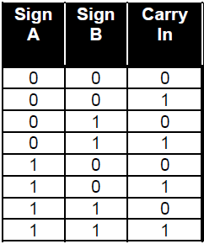
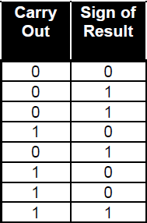
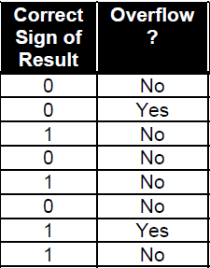
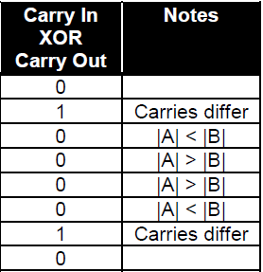
Overflow Detection
ov = c_{n} XOR c_{n-1}

Slide 16
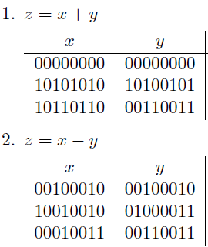
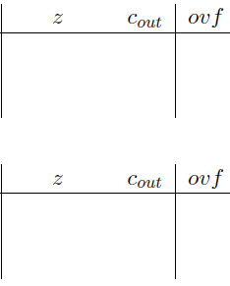


+/- in 2’s complement

